Slide 1
automatic analysis (aa): efficient and transparent multimodal neuroimaging workflows
Tibor Auer
Rhodri Cusack¹, Alejandro Vicente-Grabovetsky², Daniel J. Mitchell³, Conor J. Wild¹, Annika C. Linke¹ and Jonathan E. Peelle⁴
¹ Brain and Mind Institute, Western University, London, Canada
² Donders Institute for Brain, Cognition and Behaviour, Nijmegen, Netherlands
³ MRC Cognition and Brain Sciences Unit, Cambridge, UK
⁴ Department of Otolaryngology, Washington University in St.Louis, St.Louis, USA
Notes:
Good morning! I am Tibor Auer from MRC-CBSU, Cambridge, but…

Slide 2
aa-natomy
automatic analysis (aa)
A neuroimaging pipeline system written in Matlab
Processes:
MRI: structural, fMRI, DTI/DKI, MTI
MEG/EEG
Implements:
Most functions of SPM
Some functions of FSL and Freesurfer
State-of-art solutions from contributors and external scientists
E.g.: nl-DTI, DKI, GLMdenoise, MFP
aa-vailability
Code: https://github.com/rhodricusack/automaticanalysis
Container (docker): https://github.com/BIDS-Apps/aa (in development)

Slide 3
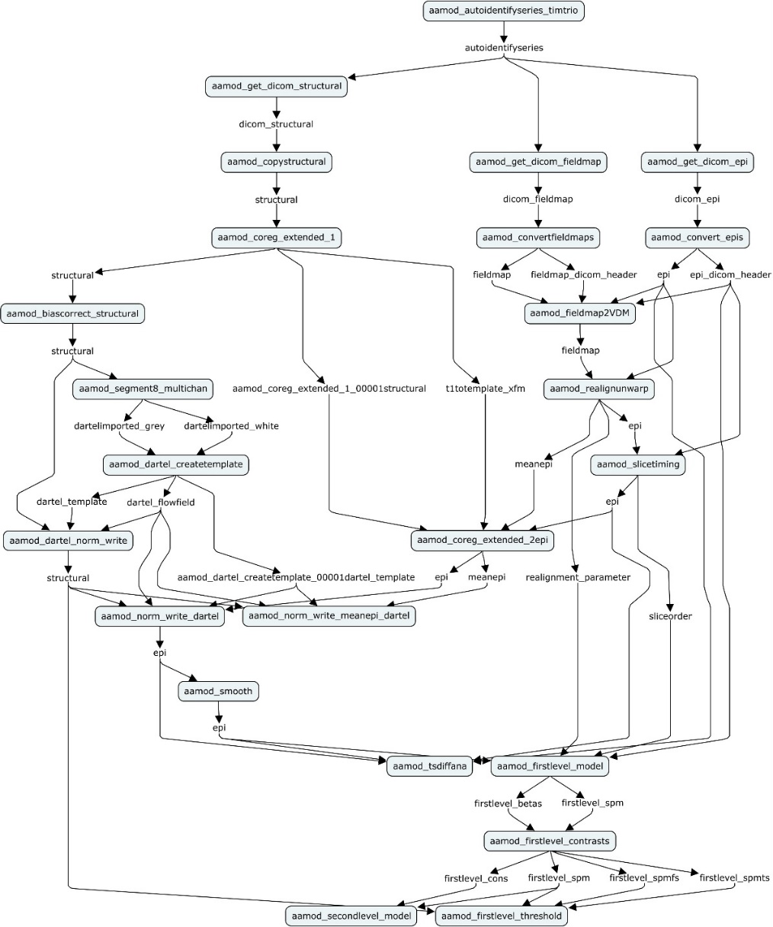
aa-natomy
Automatic, transparent, replicable workflows
Collection of „best practice” tasklists/workflows
Captures provenance (some)
Supports workflow recycling/publishing

Slide 4
aa-natomy
Efficient
Supports parallel processing
Tracks processes → Restartable
Supports site-/study-specific parameter defaults
Connects workflows: data from another aa workflow
Typical use cases:
Multimodal study: separate pipelines for each modality
Multi-model study: common pre-processing workflow + multiple models

Slide 5
aa-natomy
High-level implementation/description → Can be easily shared/published
Tasklist: XML-based workflow describing a series of modules to be executed
Easy reading/edit
Easy reordering
User Master Script: MATLAB executable
Loads in: default parameters and the tasklist with default settings
Customises: parameters and task settings
Specifies: data and analysis
Runs: analysis and clean-up
Generates: report

Slide 6
aa-natomy
Modules: independent units of the workflow
Header¹ – Data
Defines domain (i.e. once per study/subject/session/scan)
Defines inputs and outputs (streams)
Set parameter defaults²
Ensures independence → Parallel processing on cluster or cloud
Body³ – Code
Low overhead, Expandable
Notes:
Show example!
You can overwrite in UMS
Show example!

Slide 7
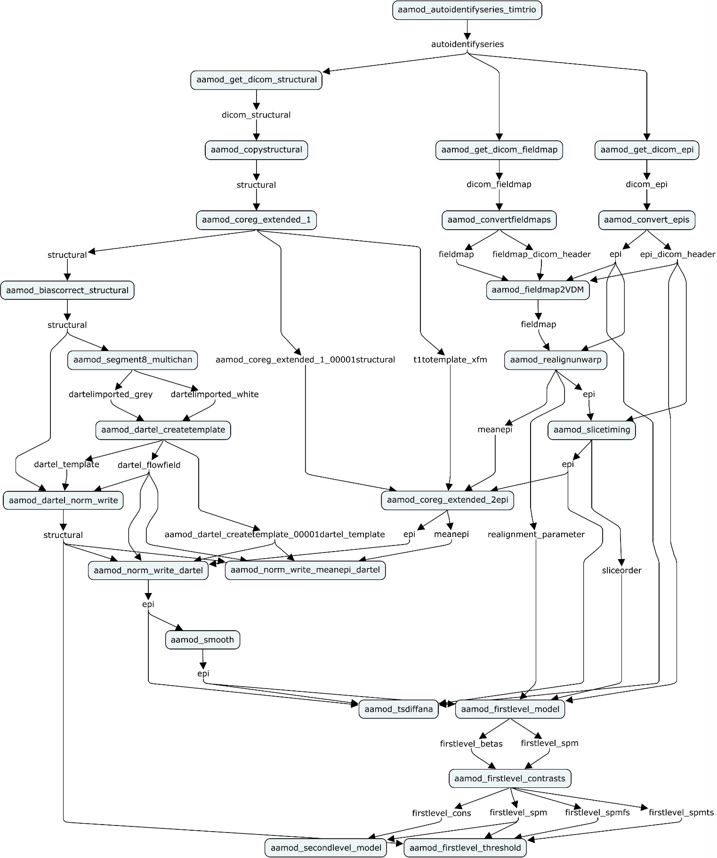
aa-natomy
Streams¹: independent units of the data
Explicitly defined by modules as their inputs and outputs.
Represent provenance (flow of data) → parallel computing, report generation
Easy reordering of the modules without worrying for filenames
Notes:
1. Filename independent

Slide 8
Input
DICOM
NIfTI
BIDS-aware
Brain Imaging Data Structure (BIDS) as input:
% Add data aap.directory_conventions.rawdatadir = '/database/BIDS/ds114'; aap = aas_processBIDS(aap);
↓
For: structural (T₁,T₂), functional + fieldmap, diffusion
Adds subjects
Adds sessions + combine
Allow selection of a subset of sessions
Allow sorting of sessions (e.g. different TR)
Adds events
(BIDS export)

Slide 9
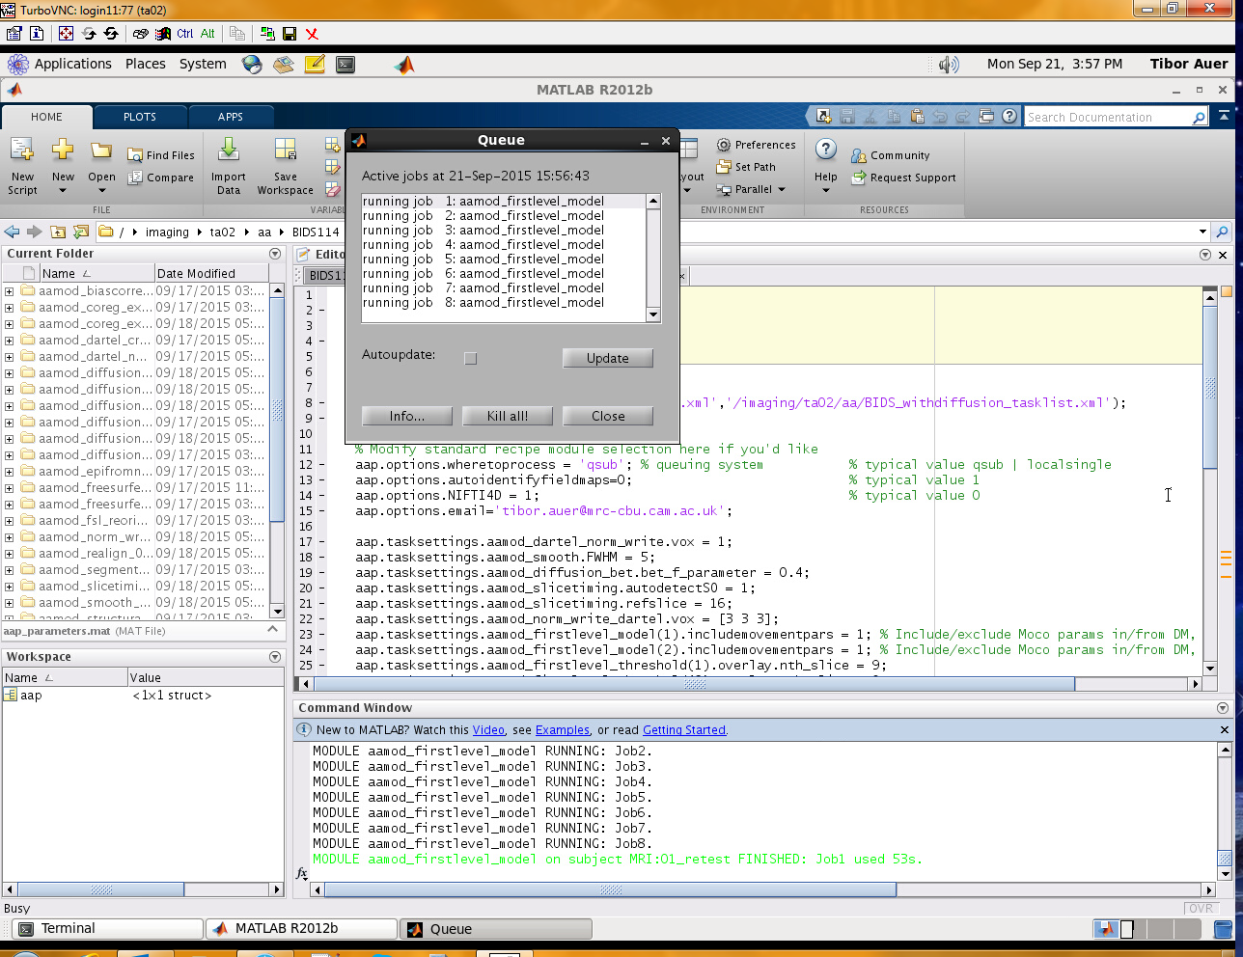
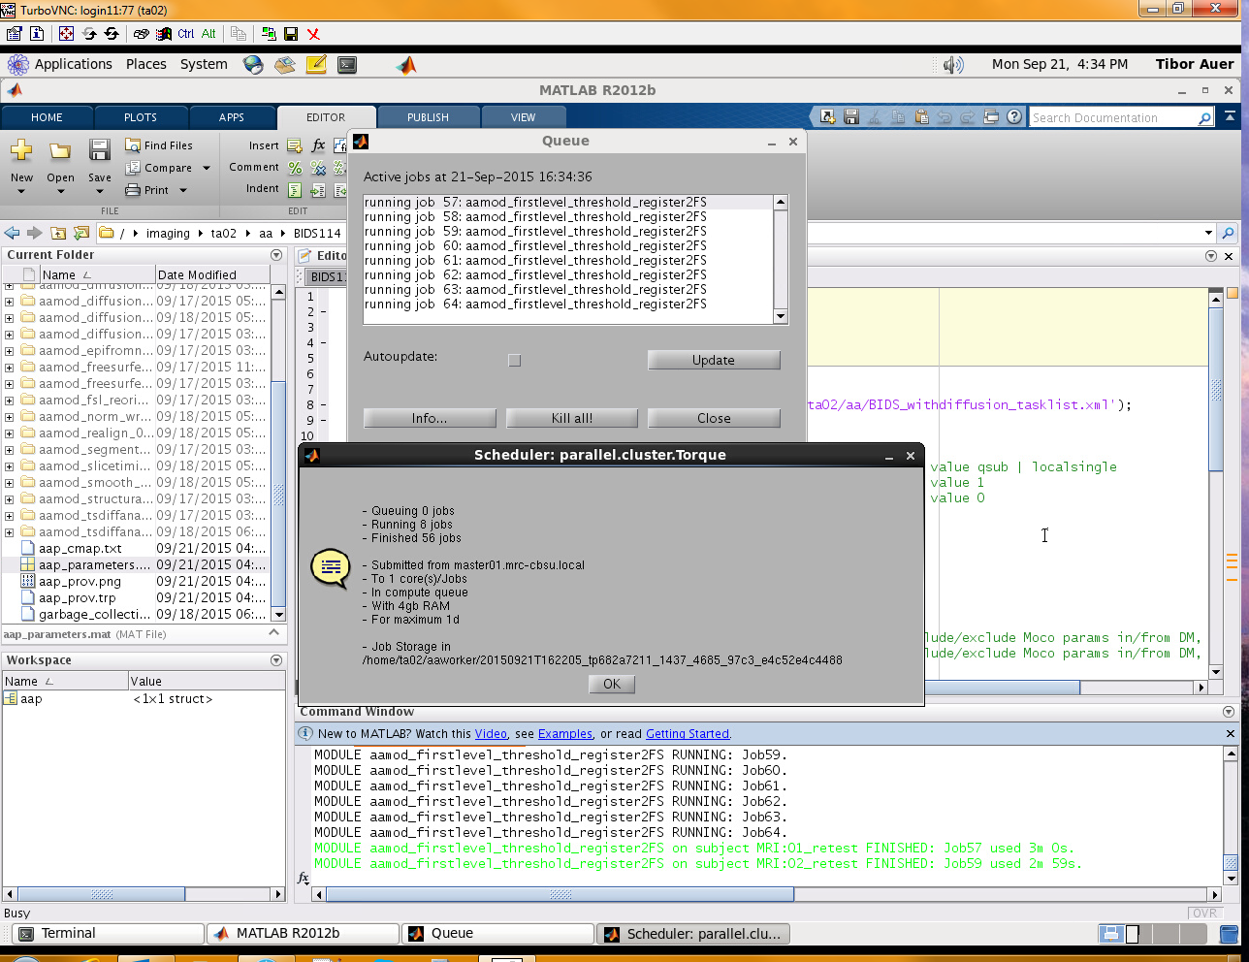
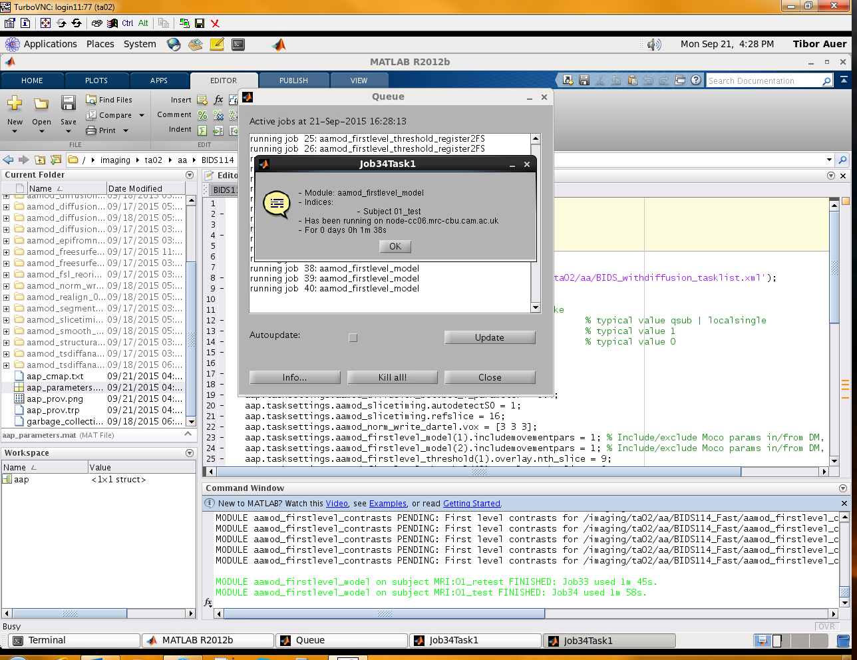
Running
Job monitoring

Slide 10
Output
Diagnostics
Between-subject summaries with descriptive stats to identify outliers
Motion
Spatial Normalisation
First-level activations
Within-subject summary to localize the erroneous stage
Notes:
0. Perhaps one of the most useful features

Slide 11
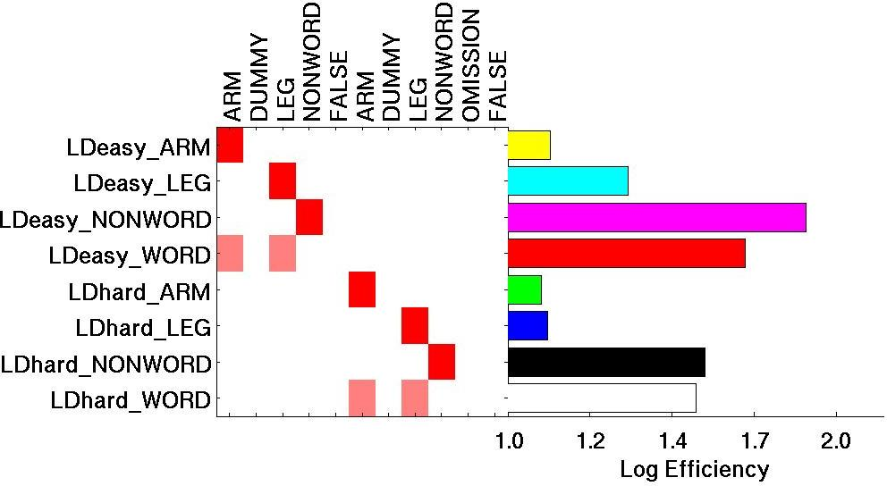
Output
Diagnostics
Intuitive graphical overview of the contrasts¹
Notes:
1. self check

Slide 12
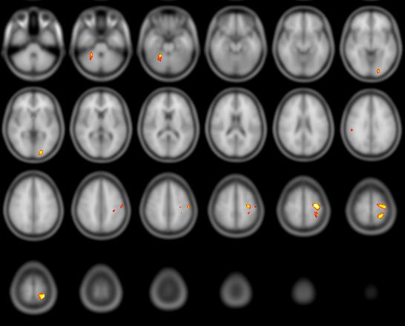
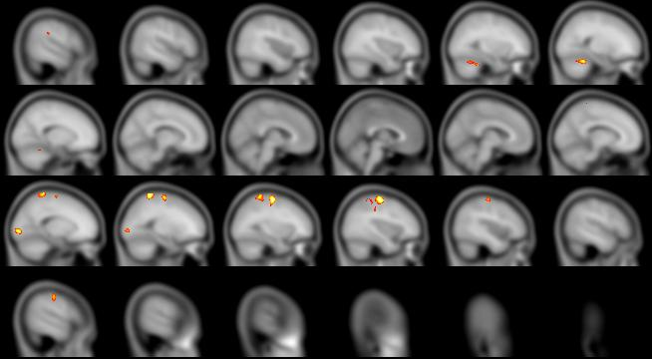
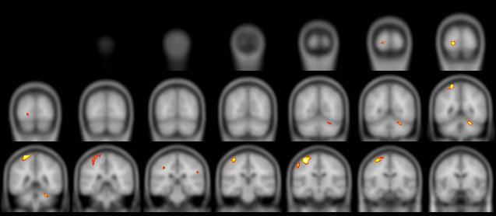
Output
Results
Activation map overlays across all three axes

Slide 13
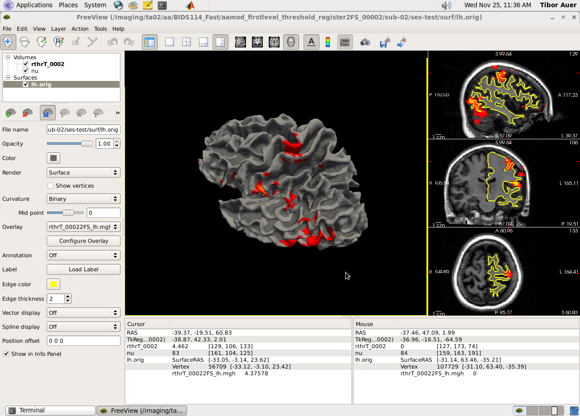
Output
Results
Activation maps projected to surface (FreeSurfer)

Slide 14

Info/Support
Website: http://automaticanalysis.org
Paper: http://dx.doi.org/10.3389/fninf.2014.00090
GitHub: https://github.com/rhodricusack/automaticanalysis/blob/v5-stable/README.md
GitWiki: https://github.com/rhodricusack/automaticanalysis/wiki
MRC-CBSU Wiki: http://imaging.mrc-cbu.cam.ac.uk/imaging/AA
Maasters
Rhodri Cusack
Alejandro Vicente-Grabovetsky
Daniel J. Mitchell
Conor J. Wild
Annika C. Linke
Jonathan E. Peelle

